Slide 1



P349 BANK Analytics

Slide 2
TABLE OF CONTENTS
1
2
2
3
INTRODUCTION
KPI’S USING EXCEL
DASHBOARDS

Slide 3


INTRODUCTION
Throughout the process of the project our team has analyzed the datasets provided to us, cleaned and queried them using tools like power query and SQL. Later we have focused on each KPI to project the results in the form of charts and dashboards. In the following slides we are going to showcase the same.
KPI’S
Year wise loan amount Stats
Grade and sub grade wise revol_bal
Total Payment for Verified Status Vs Total Payment for Non-Verified status
State wise and last_credit_pull_d wise loan status
Home ownership Vs last payment date stats

Slide 4
Year wise loan amount Stats
Data Setup:
Organize your loan data with columns for "Loan Amount" and "Year Issued".
Create Pivot Table:
Select your data.
Insert a Pivot Table.
Drag "Year Issued" to the Rows area.
Drag "Loan Amount" to the Values area.
Calculate Stats:
Right-click on any loan amount in the Pivot Table.
Choose "Summarize Values By" and select a calculation like "Sum" or "Average".
Visualize Data :
Create a chart like a bar or line chart to visualize the year-wise loan amounts.
Interpret Results:
Review the Pivot Table and chart to see how loan amounts change over the years.
Look for any noticeable trends or changes, which can help understand borrowing patterns over time.

Slide 5
Grade and sub grade wise revol_bal
Data Setup:
Ensure your loan data is organized in a table format with columns for "Grade", "Sub Grade", and "Revolving Balance (revol_bal)".
Create Pivot Table:
Select your loan data.
Insert a PivotTable.
Drag "Grade" to the Rows area.
Drag "Sub Grade" to the Rows area under "Grade".
Drag "Revolving Balance" to the Values area.
Calculate Stats:
Right-click on any "Revolving Balance" value in the Pivot Table.
Choose "Summarize Values By" and select a calculation like "Sum" or "Average".
Interpret Results:
Review the Pivot Table to see how revolving balances vary across different grades and subgrades.
Look for patterns or discrepancies in revolving balances between different grades and subgrades, which can indicate varying levels of credit risk or borrower behavior.

Slide 6
Total Payment for Verified Status Vs Total Payment for Non Verified Status
Data Setup:
Ensure your Excel sheet has columns for "Verification Status" and "Total Payment".
Each row should represent a loan, with the corresponding verification status and total payment amount.
Creating a PivotTable:
Select your loan data.
Go to the "Insert" tab on the Excel ribbon.Click on "PivotTable" and choose where you want to place the PivotTable (e.g., a new worksheet).
In the PivotTable Field List pane, drag the "Verification Status" field to the Rows area.Drag the "Total Payment" field to the Values area. This will automatically sum up the total payments for each verification status.
Interpreting Results:
In the PivotTable, you'll see the total payments for "Verified" and "Non-Verified" statuses listed separately.
You can easily compare the total payments for each verification status and see if there are any differences.This provides a clear overview of payment behavior based on verification status.

Slide 7
State wise and last_credit_pull_d wise loan status
Data Setup:
Arrange your loan data in columns, with one column for "State", another for "Last Credit Pull Date", and a third for "Loan Status".
Each row represents a loan, with details on the state, last credit pull date, and loan status.
Create a PivotTable:
Select your loan data.
Go to the "Insert" tab on the Excel ribbon.Click on "PivotTable" and choose where you want it (e.g., a new worksheet).
Drag the "State" field to the Rows area.Drag the "Last Credit Pull Date" field to the Columns area.
Drag the "Loan Status" field to the Values area. Excel will automatically count the number of loans for each state and credit pull date with different loan statuses.
Interpret Results:
In the PivotTable, you'll see loan statuses categorized by state and last credit pull date.
You can quickly see how many loans are in each status for each state and credit pull date.
This helps you understand how loan statuses vary across different states and credit pull dates.

Slide 8
Home ownership Vs last payment date stats
Data Setup:
Organize your loan data with columns for "Home Ownership" and "Last Payment Date."
Create a PivotTable:
Use Excel's PivotTable feature to count the number of loans for each combination of home ownership and last payment date.
Interpret Results:
Review the PivotTable to see how many loans have different last payment dates for each home ownership category.
This helps understand payment patterns based on home ownership status.

Slide 9
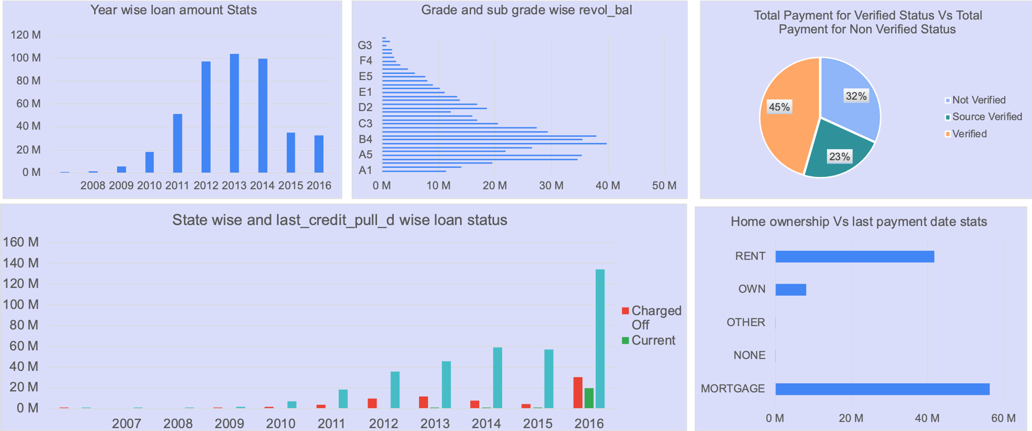
DASHBOARD USING EXCEL

Slide 10



THANK YOU!
Thank you for listening to our presentation.
Please feel free to ask any questions you may have.
OUR TEAM
Gayathri
Priyanga
Prashnnsa
Prakhar
Navya
Pradhyum
Kareena

